Slide 1

Using Frankencerts for Automated Adversarial Testing of Certificate Validation in SSL/TLS Implementations
Chad Brubaker¹ Suman Jana¹ Baishakhi Ray²
Sarfraz Khurshid¹ Vitaly Shmatikov¹
¹University of Texas at Austin
²University of California at Davis

Slide 2


Internet security = SSL/TLS

Slide 3

SSL/TLS security objectives
End-to-end security even if the network is insecure
Authentication = certificate validation!!
Confidentiality
Integrity

Slide 4

Certificate validation in SSL/TLS implementations

Slide 5
How to check if implementations are correct?
bool is_cert_valid (cert_t *cert)
{
return true;
}
How do people test SSL/TLS implementations?

Slide 6
Current state of the art
Implementation | Test certificate count
NSS | 54
GnuTLS | 51
OpenSSL | 44
PolarSSL | 18
CyaSSL | 9
MatrixSSL | 9
Most of these are just well-formed certificates!

Slide 7
Testing certificate validation code
Test input generation
Fuzzing - huge input space, a fuzzed string won't even parse as an X.509 cert
Symbolic analysis - does not scale to the complexity and depth of certificate validation code, false positives

Slide 8

Interpreting test results
SSL/TLS implementation
test certificate
accept/reject
How do you know that the result is correct?

Slide 9

Testing SSL/TLS cert validation code
We tackle both of these problems in this work
Test result interpretation
Test certificate generation

Slide 10

How to generate test certificates?
X.509 standards…ugh!

Slide 11

How to generate test certificates?
Requirements
Must generate “semantically bad” certificates
Should be syntactically correct, otherwise won’t exercise most of the cert validation code
Must scale to millions of certs
Idea
X.509 certs contain structured data, can we exploit that?

Slide 12
X.509 certificate structure
Multilayered structured data
Syntactic constraints for each piece
Ex: Version must be an integer
Semantic constraints for individual piece or across multiple pieces
Ex: Version must be 0, 1, or 2
Ex: if version!=2, extensions must be NULL
Version
Serial Number
Signature Algorithm Identifier
Issuer Name
Validity Period
Subject Name
Public Key Information
Issuer Unique ID
Subject Unique ID
Extensions

Slide 13
How to generate test certificates?
Create X.509 certs using randomly picked syntactically valid pieces
Likely to violate some semantic constraints i.e. will generate “bad” test certs just as we wanted
Wait, but how can we generate a large set
of such syntactically valid pieces without
reading X.509 specs?

Slide 14

Scan the internet for certificates
Collect 243,246 X.509 server certificates

Slide 15

Extract syntactically valid pieces
keyUsage extension from cert2
keyUsage extension from cert3
version from cert 1
ExtendedkeyUsage extension from cert4

Slide 16

Generate 8 million frankencerts from random combinations of certificate pieces

Slide 17
Interpret frankencert test results
Differential testing of SSL/TLS implementations
Multiple implementations of SSL/TLS should implement the same certificate validation logic
If a certificate is accepted by some and rejected by others, what does this mean?

Slide 18
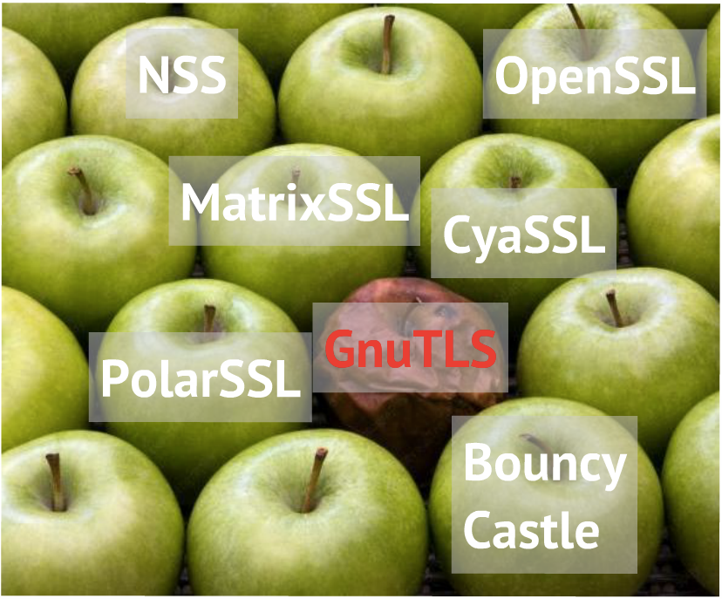
Which one is rotten ?
No false positives though some instances might be different interpretations of X.509

Slide 19
Test results summary
Tested 14 different SSL/TLS implementations
208 discrepancies due to 15 root causes
Multiple bugs
Accepting fake and unauthorized intermediate Certificate Authorities (CAs)
Accepting certificates not authorized for use in SSL or not valid for server authentication
Several other issues
attacker can impersonate any website!

Slide 20
Some test results

Slide 21
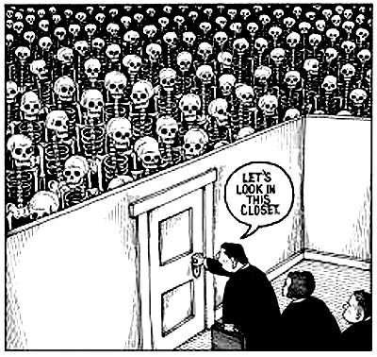
Exhibits

Slide 22
Version 1 CA certificates
If an SSL/TLS implementation encounters a version 1 (v1) CA certiﬁcate that cannot be validated out of band, it must reject it
RFC 5280 Section 6.1.4(k)
v1 CA certs do not support the CA bit: anybody with a valid v1 certificate can pretend to be a CA

Slide 23
Exhibit 1: GnuTLS
/* Disable V1 CA flag to prevent version 1 certificates in a supplied chain. */
flags &= ˜(GNUTLS_VERIFY_ALLOW_X509_V1_CA_CRT);
ret = _gnutls_verify_certificate2 (flags,..))
int _gnutls_verify_certificate2(flags, ..)
{
if (!(flags & GNUTLS_VERIFY_DISABLE_CA_SIGN) &&
((flags &GNUTLS_VERIFY_DO_NOT_ALLOW_X509_V1_CA_CRT)
|| issuer_version != 1))
{
/*check the CA bit */
}
}

Slide 24
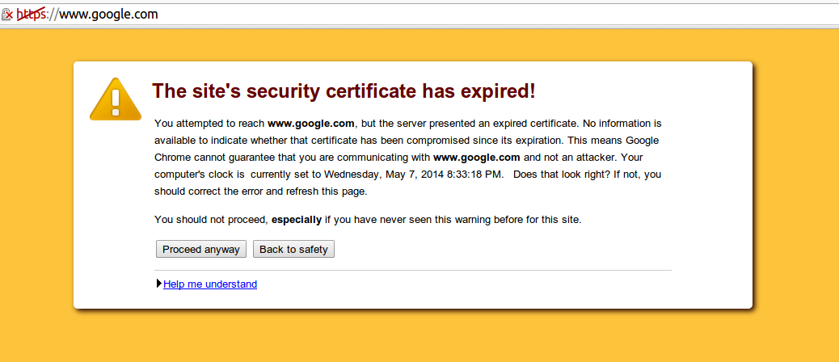
Exhibit 2: Google Chrome
OK to click through?

Slide 25
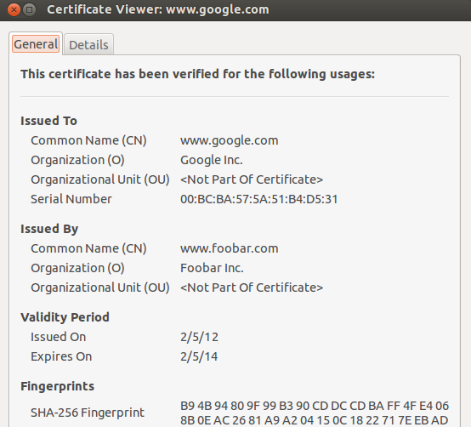
Exhibit 2: Google Chrome
untrusted CA

Slide 26
Exhibit 2: underlying cause
Chrome uses a modified version of NSS for SSL certificate validation
If a certificate is issued by a untrusted CA and is expired, the validation code only returns the expired error
Firefox uses a glue layer called Personal Security Manager (PSM) over NSS and thus is not affected

Slide 27

Check the paper for more such goodies!!

Slide 28

Conclusions
Differential testing with frankencerts is an effective technique for finding flaws in SSL/TLS implementations
Start integrating frankencerts with the test harness of your SSL/TLS implementation. The code is available at: https://github.com/sumanj/frankencert

Slide 29
Backup Slides

Slide 30
Frankencert features
Frankencerts are random, yet syntactically correct X.509 certificates with …
Unusual extensions
Rare and malformed values for these extensions
Strange key usage constraints
Rare combination of extensions
... and many other unusual features

Slide 31
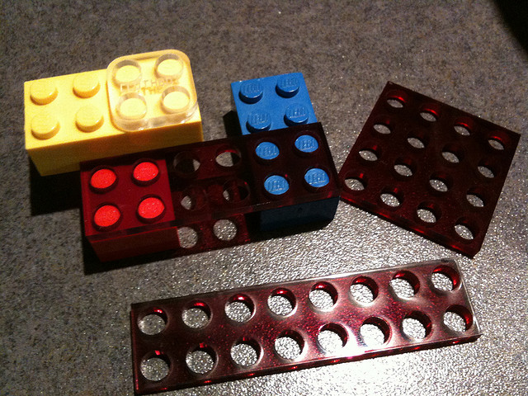
Mutate a few pieces randomly

Slide 32
Exhibit 2: MatrixSSL
/* Certificate authority constraint only available in version 3 certs */
if ((ic->version > 1) && (ic->extensions.bc.ca<= 0)) {
psTraceCrypto(“no CA permissions\n");
sc->authStatus = PS_CERT_AUTH_FAIL_BC;
return PS_CERT_AUTH_FAIL_BC;
}

